Slide 1
GPU PROGRAMMING
Lecture #2
Dolly Sapra

Slide 2
QUICK RECAP

Slide 3

The story so far…
Introduction: why do we want to use GPUs?
  Performance, energy efficiency, price
Basics of GPU architecture
Basics of GPU programming

Slide 4


















High-level architecture
SM = streaming multiprocessor
GPU
CPU
control
SM
SM
SM
SM
…
L1
L1
L1
L1
L2 cache
Host memory
dma
Device memory

Slide 5
CUDA program : RECIPE!
Identify the function(s) to offload
Determine mapping of operations and data to threads
Write Kernel(s) and device functions
  Kernel: Sequential code, written per-thread
Determine the block geometry
  How many threads per block, how many blocks
(re)Write host code:
  Device memory initialization and copy to device (H2D)
  Kernel(s) launch(es)
  Copy results back to host (D2H)

Slide 6
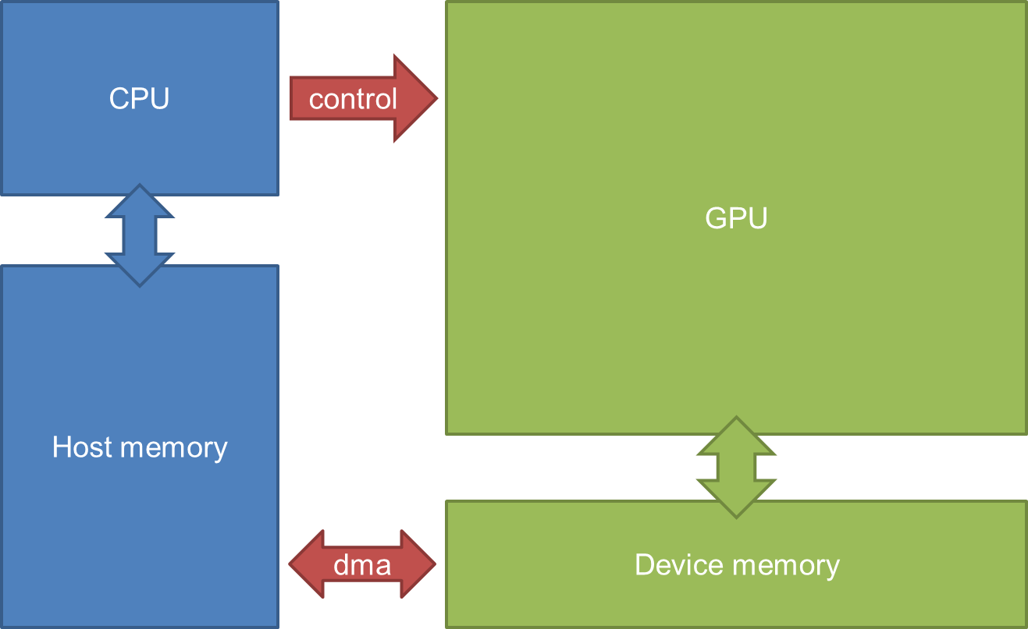
Execution flow
H: GPU memory allocation
H: Transfer data CPU→GPU
H: CPU launches GPU kernel
4.
D: GPU kernel executes
H: Transfer data GPU→CPU
H: GPU memory release
3
Device code
Host
code
4
1
H = Host D = Device
6
2
5
Numbers on following slides refer to →

Slide 7
More on Complex Geometries

Slide 8

kind of Geometries
Images, matrices, … have a 2D or a 3D data organization.
To simplify the processing of multidimensional data, CUDA supports multidimensional grids and blocks (up to 3D)
For instance, consider an HxW image
x
0
1
2
3
4
5
6
7
image[1][2]
0
y
E.g., use a grid of 2x2 blocks, each with 4x4 threads
1
2
3
y
4
5
6
7
x

Slide 9
kind of Geometries
In CUDA a grid is actually a 3D array of blocks, and each block is a 3D array of threads. These dimensions can be specified using the dim3 data type (an integer vector type of 3 elements)
For instance, to define the geometry of the previous example (2x2 blocks, each of 4x4 threads)
dim3 dimGrid(2,2,1); // x,y,z
dim3 dimBlock(4,4,1);
kernel<<<dimGrid, dimBlock>>>(...);
For convenience, CUDA provides a shortcut for calling a kernel with one-dimensional grids of block without using a dim3 parameter
kernel<<<numBlocks, ThreadsPerBlock>>>(...);
equivalent to:
dim3 dimGrid(numBlocks,1,1); // x,y,z
dim3 dimBlock(ThreadsPerBlock,1,1);
kernel<<<dimGrid, dimBlock>>>(...);

Slide 10
Indexing
For 1D geometry, we used information about block dimensions and indexes, thread indexes
Block 0
Block i
blockIdx
0
1
2
255
0
1
2
255
my_id = blockDim.x * blockIdx.x + threadIdx.x;
blockDim
threadIdx
For 2D (and 3D) geometries, we use the same type of information…also considering other dimensions. For instance in 2D:
x
y
row = blockIdx.y * blockDim.y + threadIdx.y
col = blockIdx.x * blockDim.x + threadIdx.x
y
row = 1 * 2 + 1 = 3
col = 2 * 2 + 0 = 4
threadIdx.x = 0
threadIdx.y = 1
blockIdx.x = 2
blockIdx.y = 1
x

Slide 11
Indexing
Built-in variables and functions valid in device code,
used to retrieve the “geometry” of the grid.
dim3 | gridDim; | // | Grid | dimension
dim3 | blockDim; | // | Block | dimension
dim3 | blockIdx; | // | Block | index
dim3 | threadIdx; | // | Thread | index
What is a thread’s ID?
  At block-level: threadIdx (1D, 2D, 3D)
At grid-level:
f(threadIdx, blockIdx, blockDim)

Slide 12
Data in Memory
Multidimensional data can bel represented (or flattened) in 1D array
Convention in C is to store data in row major ordering: elements in the same row are contiguous in memory.
[0,0]
[0,1]
[0,2]
[0,3]
To compute the position of image[i][j] we use the width :
[1,0]
[1,1]
[1,2]
[1,3]
image[i][j] = image[i*width + j]
[2,0]
[2,1]
[2,2]
[2,3]
image[1][2] = image [1*4+2 = 6]
[3,0]
[3,1]
[3,2]
[3,3]
Stored in row maj. as
[0,0]
[0,1]
[0,2]
[0,3]
[1,0]
[1,1]
[1,2]
[1,3]
[2,0]
[2,1]
[2,2]
[2,3]
[3,0]
[3,1]
[3,2]
[3,3]

Slide 13
Moving Data To/From the GPU

Slide 14
Transferring Data To/From the GPU
Host and Device memory spaces are separated.
Data must be copied between the two.
Explicit allocation and management:
Data is allocated twice (on the host and on the device)
Data is copied explicitly from host to device (H2D) and vice versa (D2H)
Copies exists on both sides (coherence is left to the user)
Enable asynchronous copies (we will discuss this later)

Slide 15
Explicit Memory Operations
Basically we need to perform three types of operations:
Allocating the memory
Copy the data from/to the host to/from the device
Free the memory
Allocating the memory: note, this must be done both for host and device. For the device:
​cudaError_t cudaMalloc(void** devPtr, size_t nbytes)
Example: allocate a device array x of N float numbers
Notes:
Convention: clearly identify host/device variables (prefix/append _d/_h)
Error checking is suggested (but we will skip for the sake of conciseness)
float *x_d;
size_t size = n * sizeof(float);
cudaMalloc((void**) &x_d, size);

Slide 16
Explicit Memory Allocation
Copy the memory from/to host to/from device:
cudaError_t cudaMemcpy(void* dst, const void* src,
size_t count, cudaMemcpyKind kind)
where:
enum {
cudaMemcpyHostToDevice,
cudaMemcpyDeviceToHost,
cudaMemcpyDeviceToDevice
} cudaMemcpyKind
Freeing the memory:
cudaError_t cudaFree(void* devPtr)
There are others memory management functions (e.g., cudaMemset), they are similar to their C-equivalent. Have a look at them!
For more details checkout the cudaMemcpy Nvidia Documentation

Slide 17
__global__ void scal(int N, float alpha, float *x, float *y) {
//..
}
int main(int argc, char **argv){
int N = //...
float *x_h = malloc(N * sizeof(float)); float *y_h= //...
float *x_d, *y_d;
cudaMalloc((void **)&x_d, N * sizeof(float));
cudaMalloc((void **)&y_d, N * sizeof(float));
cudaMemcpy(x_d, x_h, N * sizeof(float), cudaMemcpyHostToDevice);
scal<<<(N/128)+1, 128>>>(N, alpha, x_d, y_d);
cudaMemcpy(y_h, y_d, N * sizeof(float), cudaMemcpyDeviceToHost);
cudaFree(x_d); cudaFree(y_d);
free(x_h); free(y_h);
}
Cuda Functions are (in this case) executed in the same order they appear in the program.
cudaMem operations are blocking
(so cudaDeviceSynchronize is not needed in this example)

Slide 18
Unified Memory
CUDA 6 (the SDK, 2013), introduced Unified Memory, which creates a pool of managed memory shared between CPU and GPU
Managed memory is accessible to both the CPU and GPU using a single pointer. Data can reside in the CPU physical memory, the GPU physical memory, or even both.
CPU
GPU
CPU
GPU
vs
CPU MEM
GPU MEM
UNIFIED MEMORY
The CUDA runtime takes care of migrating data between the host and device memory spaces as needed, transparently to the user
Implementation is Hardware dependent (look at the CUDA capability of your card)
For this course, we focus ONLY on explicit memory allocation

Slide 19
Multiple Applications Running on one GPU
NVIDIA Multi-Process Service (MPS):
  This server acts as a proxy between applications and the GPU.
  ”Funnel" multiple applications into a single CUDA context,
    when the applications' workloads are small enough to allow for it.
NVIDIA Multi-Instance GPU (MIG): This hardware-based partitioning technology
  Physically separates a single GPU into multiple, independent GPU instances.
  Each instance has its own set of compute cores, memory, and caches.
  This allows multiple applications to run on different partitions of the same GPU at the same time, with no resource contention.
  MIG also provides better security and fault isolation
MPS (Multi-Process Service) is a software-based sharing method
MIG (Multi-Instance GPU) is a hardware-level partitioning
creates up to seven physically isolated instances from a single GPU,

Slide 20
EXCERCISE

Slide 21
MEMORY SPACES

Slide 22









Multiple Device Memory Scopes
Per-thread local memory
  Each thread has its own local memory.
  Stores private data (in registers)
  Accessible to a single thread only
Thread
Registers
On-chip
Local Memory
Off-chip, uncached
Device / global memory
  Accessible to any thread
Per-SM shared memory
Kernel 0
Off-chip, uncached
…
Global Memory
Kernel 1
…
Block
Each block has its own shared memory
Stores data accessible to all threads in the
same block.
Per-SM Shared Memory
On-chip

Slide 23
Memory spaces: Per thread
Thread
Registers
Local Memory
Example:
global void aKernel(float *C, float *A, float *B) { int tx = threadIdx.x; // local variable in registers float local_sum[4]; // small compile-time sized array
}
Registers:
Thread-local scalars or small constant size arrays stored as registers
Implicit in the programming model
Not persistent: kernel ends, data is lost
Does not fit (max 255 per thread)?
  Spilled to device memory → SLOW !

Slide 24








Memory spaces: DEVICE memory
Kernel 0
…
Global Memory
Per-device Global Memory
Kernel 1
…
Example:
global void matmul_kernel(float *C, // C points to device mem
float *A, // A points to device mem float *B) // B points to device mem
Device memory
Allocated by the host program using cudaMalloc()
Initialized by the host program using cudaMemcpy() or previous kernels
Persistent = the values are retained between kernels
Not coherent, writes by other threads might not be visible until kernel has finished!

Slide 25

Memory spaces: Shared memory
Block
Per-SM Shared Memory
Example:
global void matmul_kernel(float *C, float *A, float *B) {
shared__ float sh_A[THREAD_BLOCK_SIZE]; // array in | shared | mem
// all threads work together to load the A array into sh_A[threadIdx.x] = A[threadIdx.x]; | shared | mem
syncthreads(); // wait for all threads in the block
// Now sh_A can be used. All threads in this thread block can read all elements
}
Variables have to be declared using __shared__ qualifier, size known at compile time
In the scope of thread block, all threads in this thread block see the same piece of memory
Not initialized, threads have to fill shared memory with meaningful values
Not persistent, after the kernel has finished, values in shared memory are lost
Not coherent, syncthreads() is required to make writes visible to other threads within the thread block

Slide 26
Memory spaces: Shared memory
Block
Per-SM Shared Memory
On-chip Memory : higher bandwidth and lower latency
Small size : 64-96kB
Allocated per block - all threads in the block have access to the same shared memory
Often require synchronization
Shared memory is further divided into banks for simultaneous data access
Can lead to bank-conflict.

Slide 27
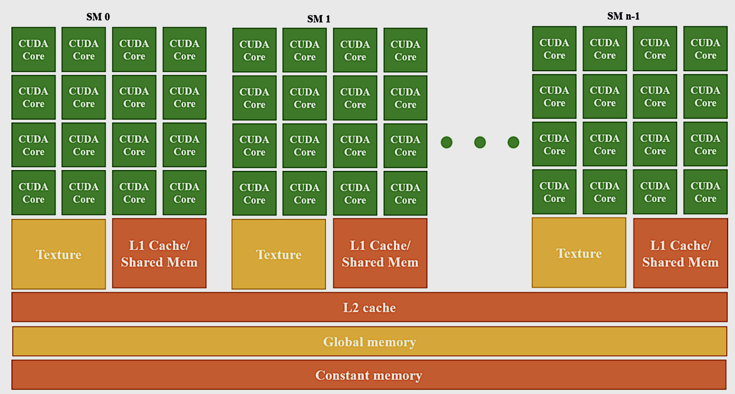
Revisiting GPU architecture

Slide 28
Memory spaces: texture memory
Textures
  Read-only for GPU
  Initialized by CPU through special constructs
  Data resides in device memory
  Different read path, includes specialized caches
  Cache misses for textures can have more severe penalty
  Testure memory is useful for hardware interpolation (while handling graphics)
*Examples at:
http://docs.nvidia.com/cuda/cuda-c-programming-guide/index.html#texture-memory
Notes:
>There is no dedicated texture memory in current architectures. Textures are stored as global memory which is bound to a given texture reference. CUDA provides an API for this.
>The texture units have a small read cache, and that cache often provides some speed up over reading from global memory, although cache misses can hurt performance depending on the spatial organization of the data bound to a texture and access patterns.
>Texture references provide a method for CUDA kernels running on the shader cores to transparently fork texture unit threads and access data bound as textures. This data access can include filtering and interpolation, and as of CUDA 2.x can be done in 1D, 2D, or 3D.

Slide 29








Memory spaces: Constant
Kernel 0
…
Global Memory
Kernel 1
Example:
…
// scalars can be initialized directly
constant__ double pi=3.14;
// arrays must be initialized by a host function
constant__ float2 vertices[NUM_VERTICES];
Statically defined by the host program using constant qualifier
Defined as a global variable, visible only within the same source file
Initialized by the host program using cudaMemcpyToSymbol()
Read-only to the GPU, and cannot be accessed directly by the host
Values are cached in a special cache optimized for broadcast access by multiple threads simultaneously
Access should not depend on threadIdx (works, but slow)

Slide 30
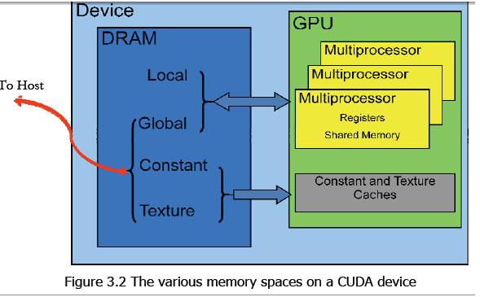
Memory hierarchy

Slide 31
Scheduling

Slide 32
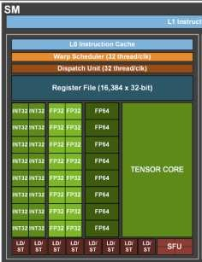

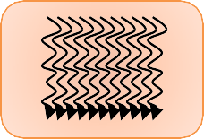
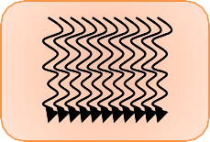

Threads in a GPU architecture
software hardware
Thread t
core
Block b
Thread block
Streaming multiprocessor
…
…
Grid
Device
Notes:
.

Slide 33
CUDA Kernel
Kernel:
Function which is executed on the GPU.
Host launches a grid of ‘kernels’ ( → of blocks → of threads)
Max number of blocks in x-dimension is 2³¹-1
Block can have max 1024 threads
Large number of concurrent threads
    Much higher than available cores
          Scalability and Scheduling are important!

Slide 34
Threads in a GPU architecture
A block runs within one SM
A block can have max 1024 threads (For most GPUS)
    > There can be more threads (in a block) than cores in an SM
Max number of blocks in x-dimension is 2³¹-1 (For most GPUS)
    > There can be more than one block per SM
    CPU can continue to launch more/different kernels on the GPU
    Scheduling is important!
      > Memory accesses take longer than computation
      > Handling memory accesses is important.

Slide 35
What Happens When We Execute a CUDA Program?
Host: Tasks (copy data, execute kernels, …) for the GPU are pushed into a “queue” (the default stream), and executed in order.
Device: the hardware takes care of execution the tasks:
Data transfers are performed by DMA Engine (copy engine)
Threads/Blocks are scheduled on the Core/SMs by the hardware scheduler (known as GigaThread Engine in older GPU generations)
Q: What does it mean scheduling in a computing system?
Allocating the various resources of the system for the execution of a set of tasks. Mapping + Ordering (+ Timing)

Slide 36
Scheduling on The GPU
We have our program (that defines a thread hierarchy) and we want to map it on the hardware
Grid
How can we run a program with 2048 blocks, each with 512 threads on a GPU that has 5120 cores (organized in 80 SMs)? How we do it efficiently?
Thread Block
Thread Block
Thread
Thread
Thread
Thread
The user want to not change their program if they change the hardware. Scheduling must be transparently scalable
schedule on
This is a task for the HW scheduler, not a programmer’s problem
Let’s start with scheduling Thread Blocks

Slide 37
Block Scheduling
Threads are assigned to SMs at block granularity. All threads in a block are assigned to a single SM.
SP
SP
SP
SP
SP
SP
SP
SP
SP
SP
SP
SP
Thread Block
SP
SP
SP
SP
Thread Block
Control
Control
MEM
MEM
Multiple blocks can be assigned to the same SM.
Limited number of blocks can be assigned simultaneously to the SM
(max number of resident block and threads per block defined by the CUDA capability)
(Most grids will contain many more blocks than this number. It is the HW that will schedule them)
Notes:
blocks need to reserve hardware resources to execute,

Slide 38

Block Scheduling
The assignment of threads to SMs on a block basis guarantees that threads in the same block are scheduled simultaneously* on the same SM
This allows threads in the same block to cooperate (e.g., they can access the local SM’s shared memory)
SP
SP
SP
SP
SP
SP
Important: CUDA runtime system can execute blocks in any order!
SP
SP
Thread Block
Control
Your application must work properly independently from the block ordering!!
MEM

Slide 39
Block Scheduling : SUMMARY
Blocks are scheduled on the SM based on SM availability and shared-memory availability
Allocation would vary every time you launch the kernel.
Order of execution also varies
Can have different solutions due to floating point rounding-off errors.

Slide 40
Thread Scheduling
Each block is divided into “W-threads” units called Warps (wavefront for AMD).
So far W = 32 (64 for AMD), but is not standardized
B1
Warps are the scheduling unit in a SM
t₀
t₁
…
t₃₁
B1 warps
SP
SP
Q: If three blocks of 256 threads are assigned to an SM, how many warps are there in the SM?
SP
SP
B2
t₀
t₁
…
t₃₁
B2 warps
SP
SP
SP
SP
256/32 = 8 warps per block
8*3 = 24 warps in the SM
Control
B3
MEM
t₀
t₁
…
t₃₁
B3 warps
Notes:
This part of the implementation, not of the programming model
Warps are divided based on the linearized thread index

Slide 41
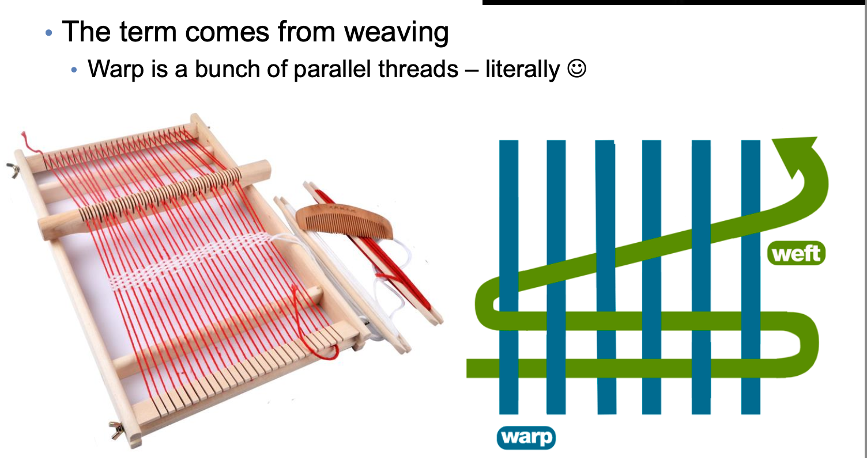
Warps
Warps are the basic unit of execution on the GPU.

Slide 42
Warps
Warps are the basic unit of execution on the GPU.
> Number of threads in a warp are fixed as per GPU architecture
> A block forms the unit of resource assignment
> A warp is the basic unit of actual execution.
> Programmer chooses block size/dimensions
> Modern GPUs have 32 threads in a warp. (Fixed number)
> If less number of threads than warp size, then some cores would be inactive.
> All warps within a block are launched on a particular SM
> A warp cannot have threads from different blocks.

Slide 43
Warps
The SM creates, manages, schedules and executes warps
Each warp has contiguous thread-ID
All threads in a warp executes the same instruction.
If there is execution divergence, each branch is executed serially.
Warp “wants to” access the memory at contiguous locations >> More in next lecture
  All the warps of a block are resident in SM memory until their execution finishes.

Slide 44
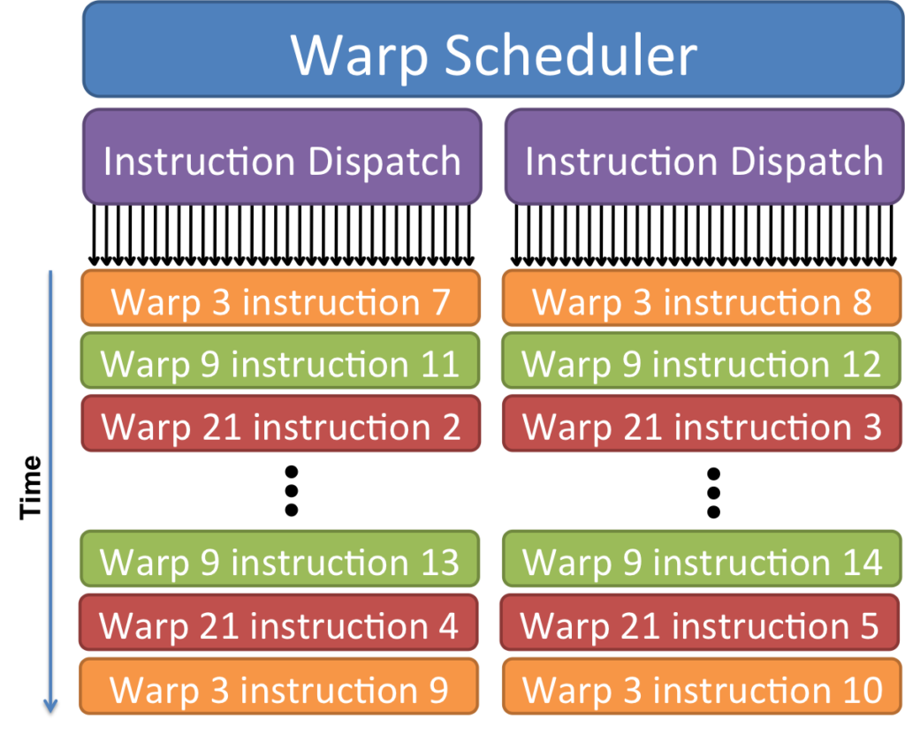
Warps
Warps are scheduled for best performance
Context Switching
All Warp data stay in registers allocated to the warp
Overlap possible between a warp’s data access and another warp’s execution
GPUs have large number of registers to allow for scalable scheduling via context switching
Notes:
HIDE LATENCY

Slide 45
Warps
Notes:
There are 2 warp schedulers. So all 64 cores are being used by 2 warps at a time.

Slide 46
Stalled Warps
• What happens if all warps are stalled?
> No instruction issued → performance lost
• Most common reason for stalling?
> Waiting on global memory
You should try to maximize occupancy
Occupancy = Active Warps / Maximum Active Warps
Potential occupancy limiters:
        • Register usage
        • Shared memory usage
        • Block size

Slide 47
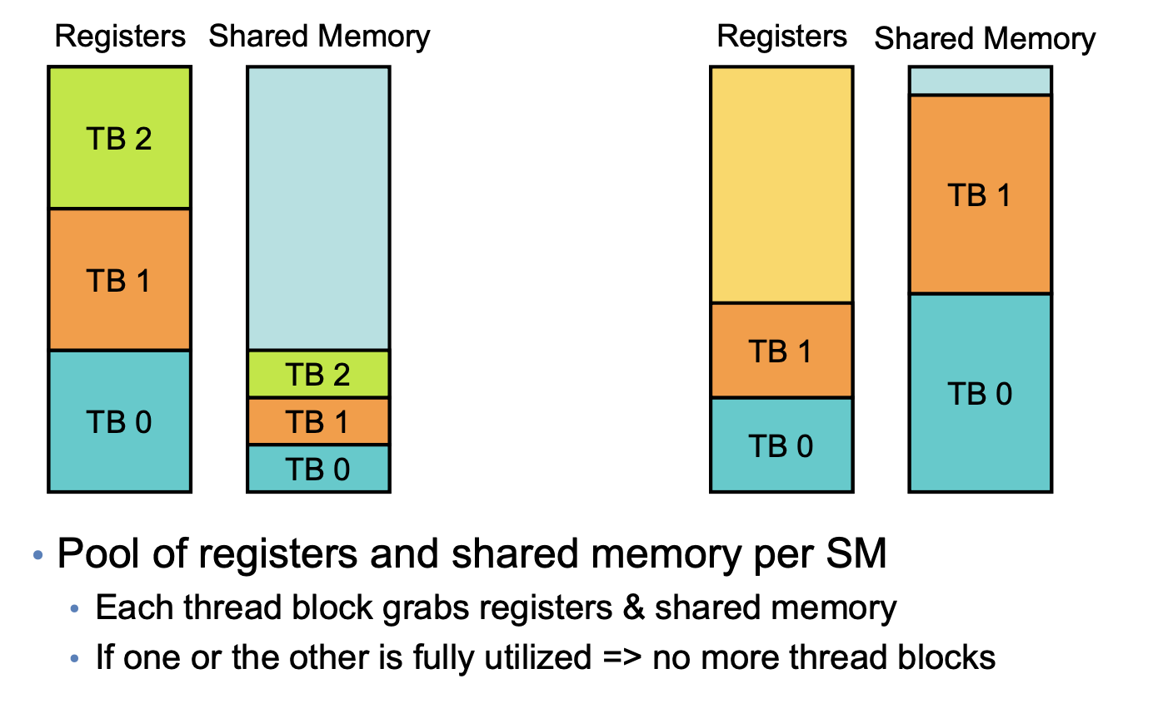
Resource limitations on SM

Slide 48
Synchronization (preview)
In CUDA programs, multiple blocks and multiple threads are simultaneously in execution, without any particular ordering. Q: Is this an issue?
i
j
__global__ void sumArray(int *arr, int *sum, int n) {
int my_id = threadIdx.x + blockIdx.x * blockDim.x;
if (my_id < n) {
*sum += arr[my_id];
}
}
arr =
7
4
sum
Ti
Tj
3
R
R
Race conditions can occur when multiple threads try to operate on the same shared data
+
+
time
W
7
W
Q: How to fix this?
10

Slide 49
Atomic Operations (preview)
Atomic operations guarantee that a single thread can read, modify, and write a value back to memory without the interference of any other threads.
__global__ void sumArray(int *arr, int *sum, int n) {
int my_id = threadIdx.x + blockIdx.x * blockDim.x;
if (my_id < n) {
atomicAdd(sum, arr[idx]);
}
}
i
j
arr =
7
4
sum
Ti
Tj
CUDA offers:
Various atomic operations as intrinsics (atomicAdd, atomicSub, atomicExch)
Operations to let threads in the same block coordinate execution (__syncthreads(), acts as a barrier)
3
R
+
time
10
W
R
We will discuss them more, but in the meanwhile a useful preview
+
14
W

Slide 50
Thread Divergence
Through conditional branches, there can be control-flow divergence.
This adds heavy latency and should be avoided
Remember: All threads in a warp execute same instruction
Notes:
Threads in a warp must follow same instruction.

Slide 51
Thread Divergence
void kernel(int *x)
{
i = int threadIdx.x;
if(i%2 == 0)
x[i] = 5;
else
x[i] = 10;
}
Notes:
Threads in a warp must follow same instruction.

Slide 52
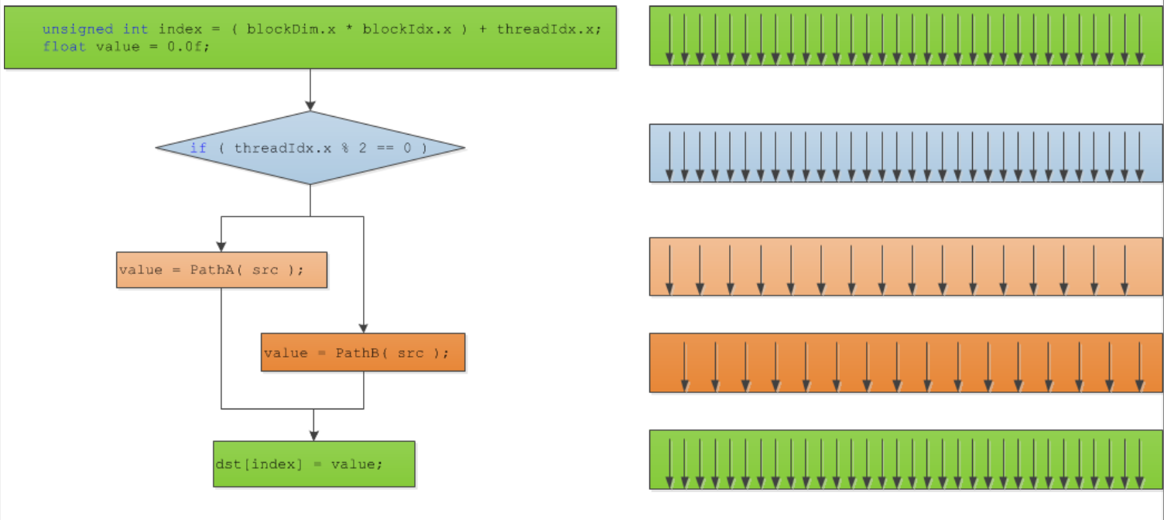
Thread Divergence
Notes:
Threads in a warp must follow same instruction.

Slide 53
Divergence can cause deadlocks
void kernel(int *x)
{
i = int threadIdx.x;
if(i%2 == 0)
__syncthread();
else
__syncthread();
}
Notes:
Threads in a warp must follow same instruction.

Slide 54
Avoiding divergence
Divergence depends on whether branching is data- or ID- dependent
• If ID – consider grouping threads differently
Diverge at warp level
Diverge at block level
  > Use threadIdx, blockIdx, blockDims etc. to ‘allocate’ tasks
If data – consider sorting
  > Launch different kernels with different execution instructions
Notes:
Threads in a warp must follow same instruction.

Slide 55
Thread Divergence
__global__ void kernel(int *x)
{
i = int threadIdx.x;
if(i%2 == 0)
x[i] = 5;
else
x[i] = 10;
}
__global__ void kernel(int *x)
{
i = int threadIdx.x;
x[i] = (1 - i%2)*5 + (i%2)*10
}
Notes:
Threads in a warp must follow same instruction.

Slide 56
Avoiding divergence
Diverge at warp level
void kernel(int *x)
{
i = threadIdx.x + blockDim.x * blockIdx.x;
if(i/32)
statement 1;
else
statement 2;
}
Notes:
Threads in a warp must follow same instruction.

Slide 57
Exercise - 1
__global__ void foo(int N, int *data){
index = threadIdx.x;
int result;
if (N % 2 == 0 )
result = N;
else
result = N*N;
data[index] = (float)result;
}
Q: is this code divergent and, if yes, what is the performance penalty?
No, this code is not divergent. The value of N is the same for all threads

Slide 58
Exercise - 2
Q: What is the #warps per block?
Q: What is the #warps in the grid?
__global__ void foo_kernel (int* a, int* b) {
unsigned int i = blockIdx.x*blockDim.x + threadIdx.x;
if(threadIdx.x < 40 || threadIdx.x >= 104)
b[i] = a[i] + 1;
if (i%2 == 0)
a[i] = b[i] *2;
}
void foo(int* a_d, int* b_d) {
unsigned int N = 1024;
foo_kernel <<< N/128, 128 >>>(a_d, b_d);
}
Q: For this statement: how many warps in the grid are active? How many are divergent?
Note the if condition on threadIdx

Slide 59
OVERLAPPING COMPUTATION AND COMMUNICATION:
92
STREAMS

Slide 60
Main performance bottleneck?
In many applications, a bottleneck is the data transfer between the CPU and the GPU!
How can we fix this?

Slide 61
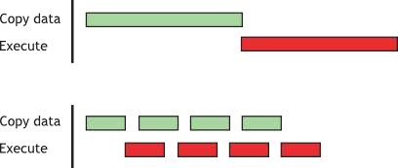
Overlap Computation and Communication
Main idea: while executing a kernel, bring data in for the
next kernel!

Slide 62
What are streams?
95
Stream = a sequence of operations that execute on the
device in the order in which they are issued by the host code.
Same stream: In-Order execution
Different streams: Out-of-Order execution
Default stream = Synchronizing stream
  No operation in the default stream can begin until all previously issued
operations in any stream on the device have completed.
  An operation in the default stream must complete before any other operation in any stream on the device can begin.

Slide 63
The default stream
96
cudaMemcpy(dA, a, numBytes,cudaMemcpyHostToDevice);
increment<<<1,N>>>(d_a);
CpuFunction(b);
cudaMemcpy(a, dA, numBytes,cudaMemcpyDeviceToHost);
All operations happen in the same stream
Device (GPU)
  Synchronous execution
    all operations execute (in order), one after the previous has finished
  Unaware of CpuFunction()
Host (CPU)
  Launches increment and regains control
  May execute CpuFunction() before increment<<<>>>() has finished
  Final copy starts after both increment and CpuFunction finished

Slide 64
Non-default streams
Enable asynchronous execution and overlaps
  Require special creation/deletion of streams cudaStream_t stream1; cudaStreamCreate(&stream1) cudaStreamDestroy(stream1)
  Special copy operations
cudaMemcpyAsync(deviceMem, hostMem, size,
cudaMemcpyHostToDevice, stream1)
  Special optional kernel parameter (the last one)
increment<<<1, N, 0, stream1>>>(d_a)
execution configuration <<<Dg, Db, Ns, S>>>, where:
Dg | (dim3) | dimension and | size of | the grid
Db | (dim3) | dimension and | size of | each block
Ns (size_t) dynamically allocated shared memory per block S (cudaStream_t) stream (optional parameter)

Slide 65
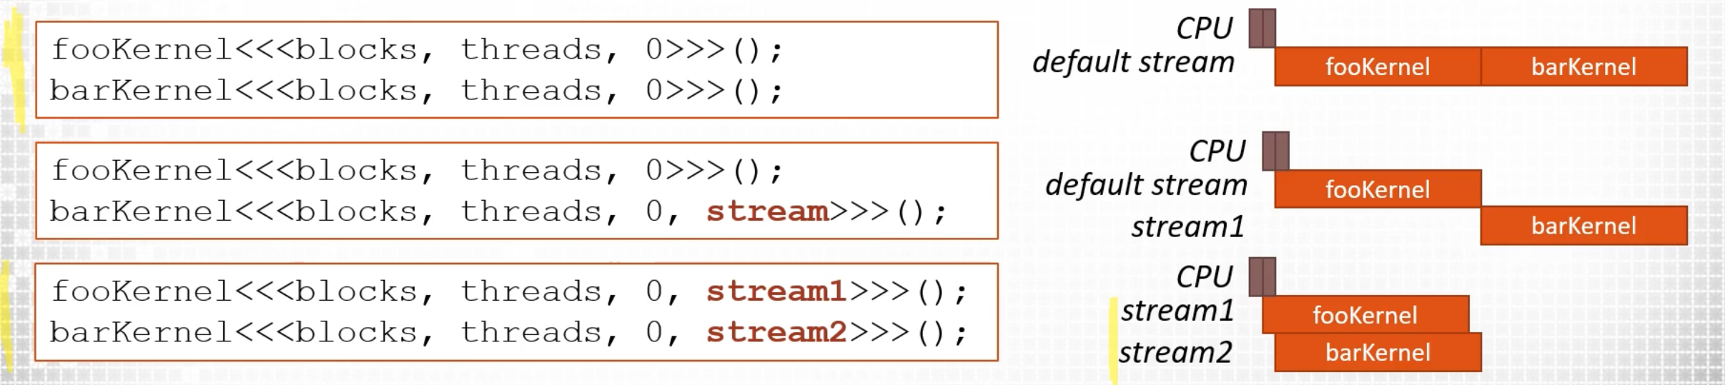
Non-default streams

Slide 66
Non-default streams
Synchronization
  All streams
    cudaDeviceSynchronize()
  Specific stream:
    cudaStreamSyncrhonize(stream1)

Slide 67
The typical vector-add
cudaMemcpy(d_a, a, numBytes, cudaMemcpyHostToDevice);
cudaMemcpy(d_b, b, numBytes, cudaMemcpyHostToDevice);
vector_add<<<blocks, threads>>>(d_a, d_b, d_c); cudaMemcpy(c, d_c, numBytes, cudaMemcpyDeviceToHost);

Slide 68
Computation-communication overlap
int nrStreams = ???; // play with this value! int streamBytes = numBytes / nrStreams;
for (int i = 0; i < nStreams; ++i) {
int offset = i * streamBytes / sizeof(int);
cudaMemcpyAsync(d_a+offset, a+offset, streamBytes, cudaMemcpyHostToDevice, stream[i]);
cudaMemcpyAsync(d_b+offset, b+offset, streamBytes,
cudaMemcpyHostToDevice, stream[i]);
vector_add<<<blocks/nStreams, threads,
0, stream[i]>>>(d_a, d_b, d_c, offset);
cudaMemcpyAsync(c+offset, d_c+offset, streamBytes,
cudaMemcpyDeviceToHost, stream[i]);
}
cudaDeviceSynchronize();
https://github.com/parallel-forall/code-samples/blob/master/series/cuda-cpp/overlap-data-transfers/async.cu

Slide 69
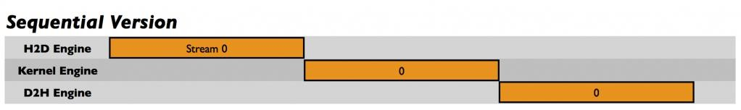
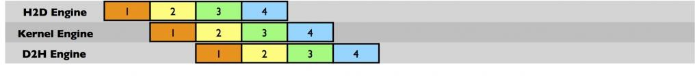
Computation-communication overlap
101
Streaming Version

